Slide 1




Class 3A Electronics Bingxiu Yu
Class 3B Electronics Chiajui Lee
Class 3C Electronics Guojun Zeng

Slide 2




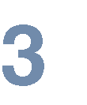

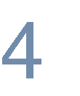




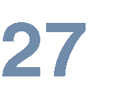


Slide 3

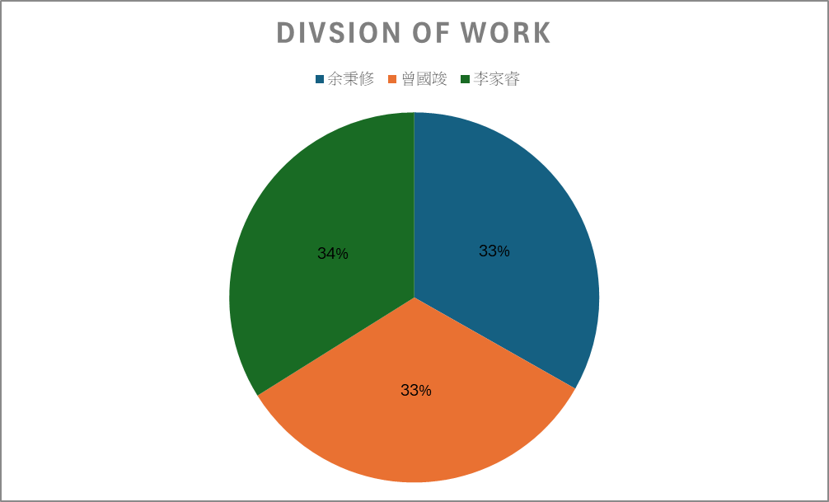




Slide 4






HTML is a standard markup language used for creating web pages. As a foundational technology, it is commonly combined with CSS (Cascading Style Sheets) and JavaScript by websites, web applications, and mobile applications to design user interfaces.
CSS is a computer language used to add styling (e.g., fonts, spacing, colors) to structured documents such as HTML or XML-based applications. It is defined and maintained by the W3C (World Wide Web Consortium).
JavaScript is a programming language used to manipulate the content and structure of HTML documents, enabling dynamic page updates without requiring reloads. It responds to user interactions (e.g., button clicks, text input) to modify a page's appearance and behavior.

Slide 5








Node.js is a JavaScript-based backend runtime environment that executes code using Chrome's V8 JavaScript engine. It specializes in providing a non-blocking (asynchronous) and event-driven architecture, making it ideal for building high-performance, scalable network applications. As a pivotal technology in modern web development, Node.js is widely used for real-time applications and API development.
Express.js is a minimalist web framework for Node.js, designed for building web applications and APIs. It simplifies handling HTTP requests, responses, and middleware in server-side development.

Slide 6


MySQL is an open-source (free) database management system widely used in small to medium-sized websites. It integrates with server-side languages like PHP, ASP, or ASP.NET to store large volumes of data. Websites with backend administrative systems (e.g., content management) typically require database functionality.
WebRTC is an open-source project that enables web browsers and mobile applications to perform real-time audio/video communication and data transfer through simple JavaScript APIs.

Slide 7



Azure Web App Services enables users to quickly deploy and manage website environments, supporting multiple development frameworks and tools. It is ideal for testing, deployment, and scaling applications. By integrating with Azure services, developers can effortlessly achieve high-performance, secure, and scalable web solutions.
WebSocket provides the foundation for real-time communication in web development, enabling persistent connections between servers and clients. It supports full-duplex data transmission, making it ideal for building:
Chat applications
Live notifications
Multi-user interactive apps
By offering high-efficiency, low-latency communication, WebSocket delivers robust real-time capabilities for modern web applications.

Slide 8


Slide 9
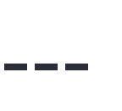






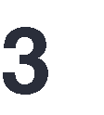








Slide 10






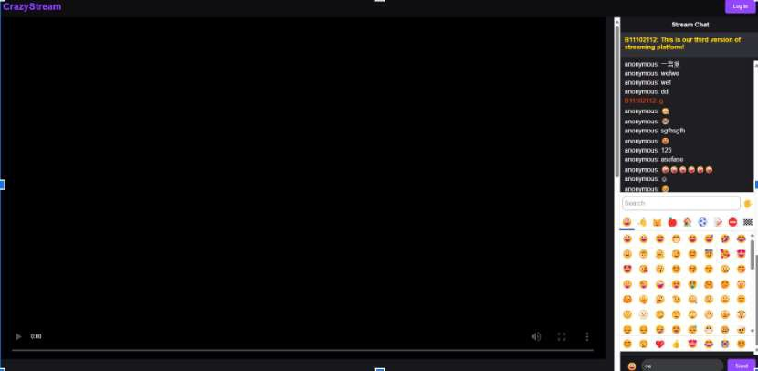






Slide 11

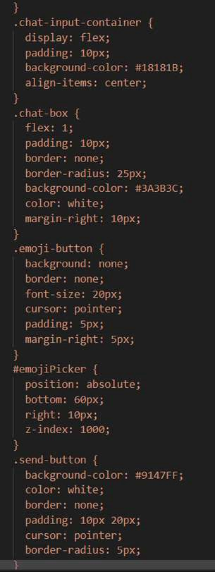

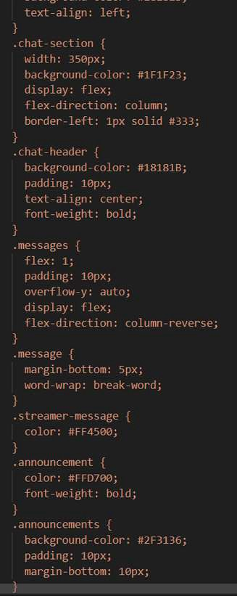
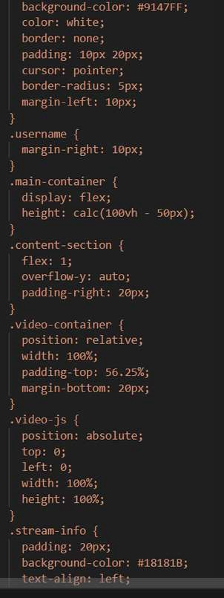
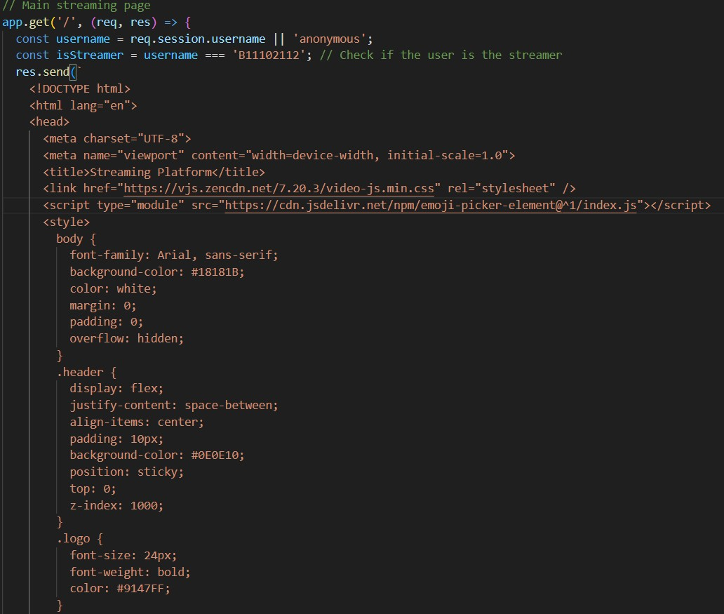


Slide 12
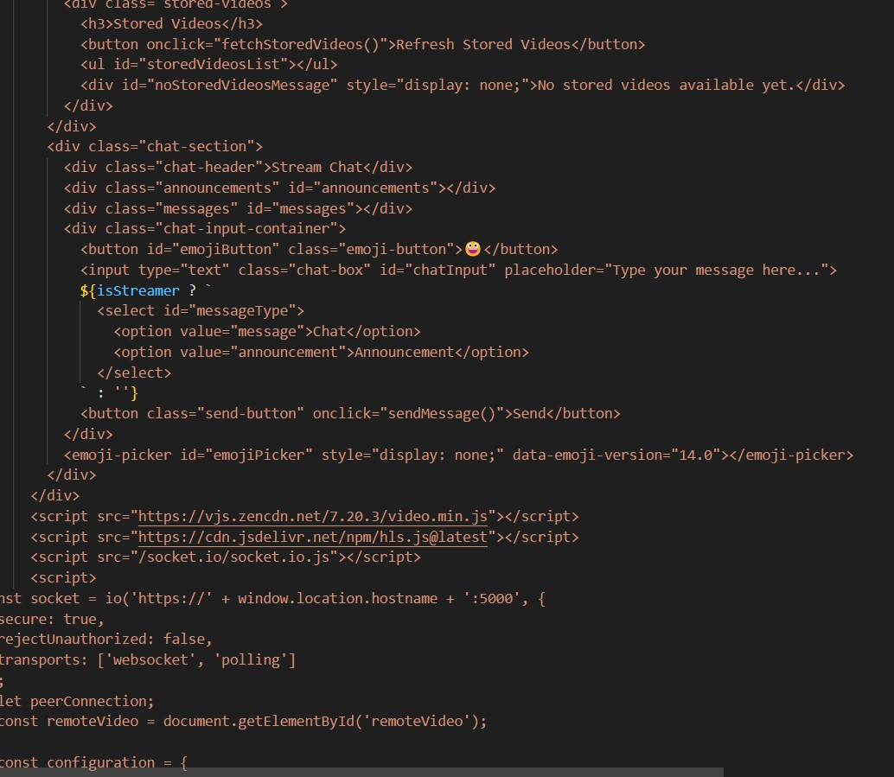
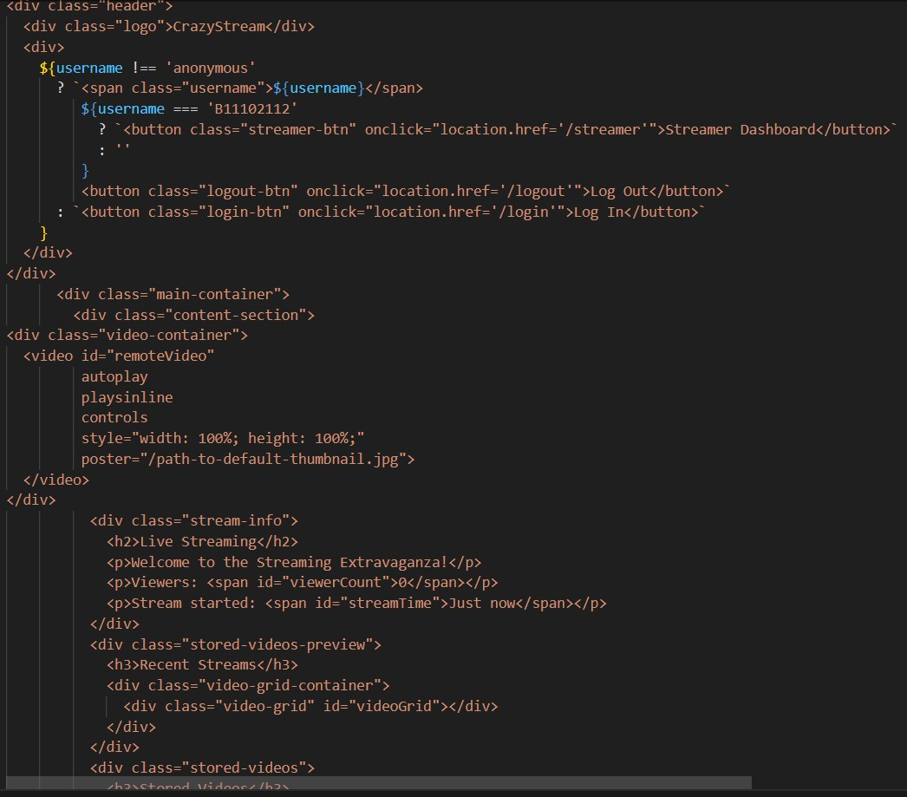

Slide 13

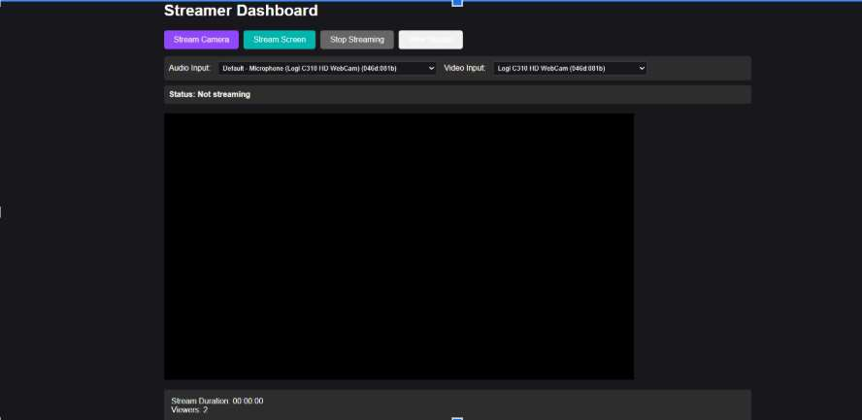









Slide 14

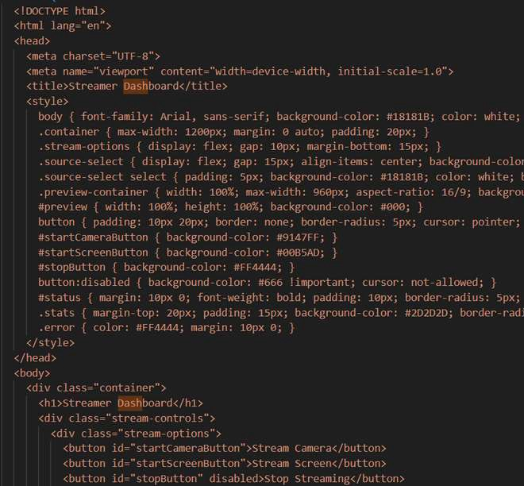
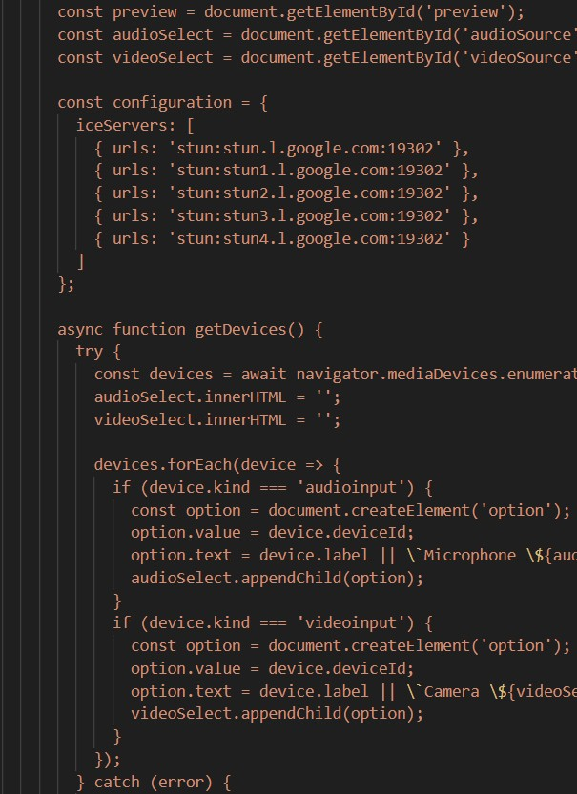
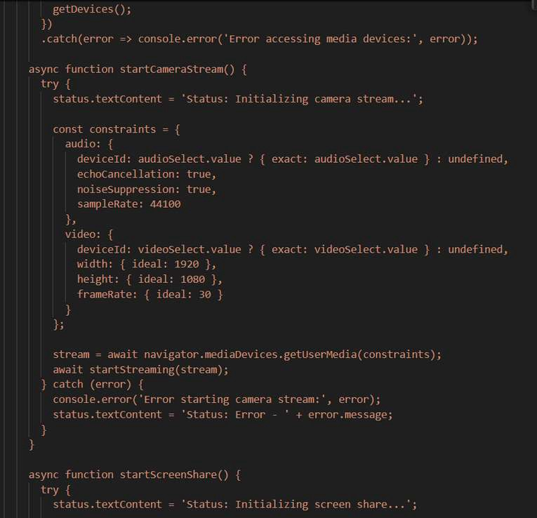

Slide 15

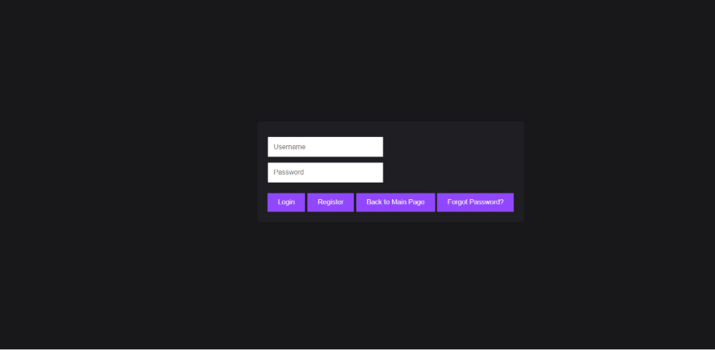







Slide 16
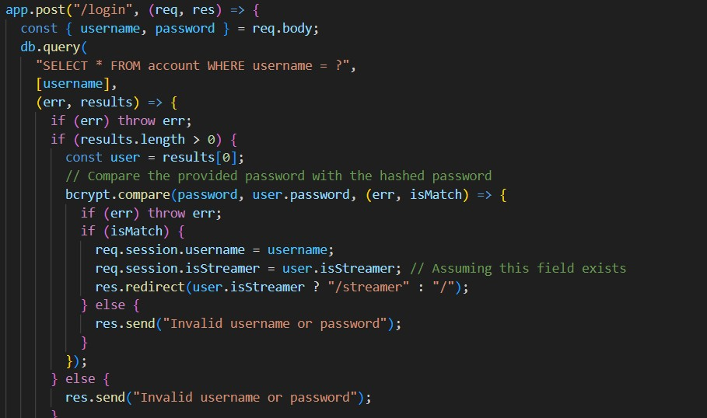

Slide 17

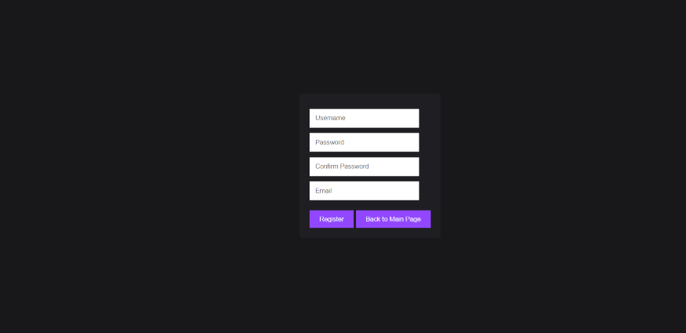

Slide 18



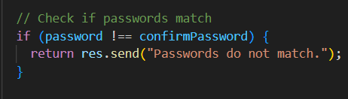
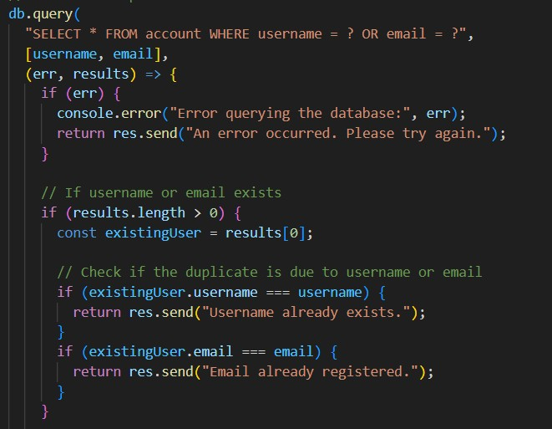

Slide 19
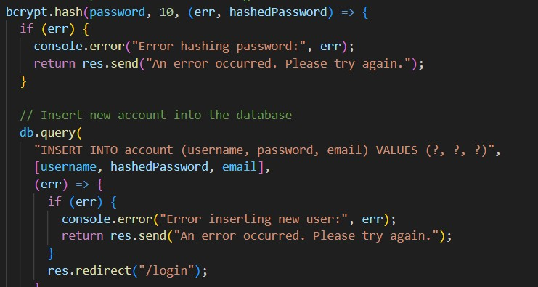

Slide 20
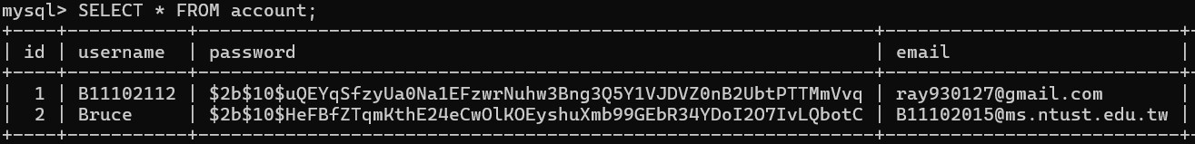
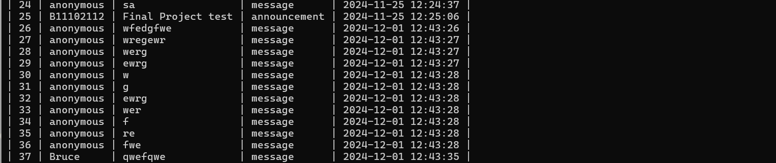

Slide 21

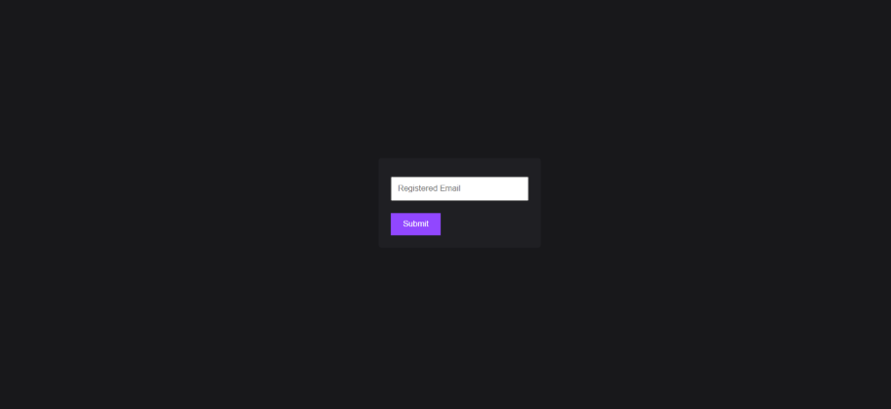

Slide 22

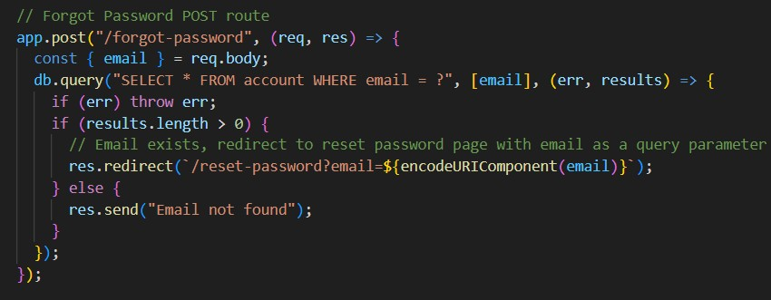
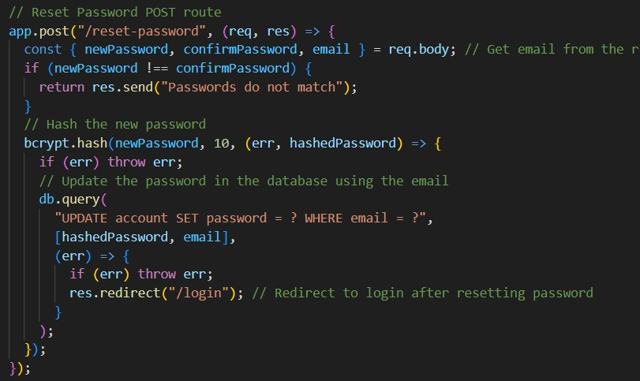

Slide 23


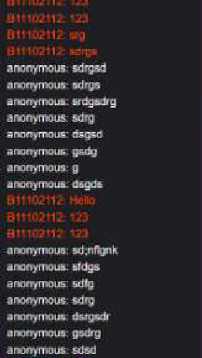



Live streamer chat interaction, real-time conversation
If the account is registered as a viewer, the name will be displayed as "anonymous".
The name you entered during registration will be displayed.

Slide 24
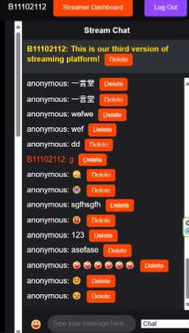


The streamer can use admin privileges to delete inappropriate messages in real-time
實況主的訊息以紅字表示
置頂留言設置功能

Slide 25
我們從課堂、實作過程中學到什麼

Slide 26



提供隨需的虛擬伺服器、儲存和網路服務
提供開發和部署應用程式的工具，無需管理基礎設施
透過網路提供即用型軟體

Slide 27



進入
服務，點選「建立資源」
選擇「虛擬機器」，設定名稱、區域和規格
確認設定，點選「檢閱並建立」，然後「建立」

Slide 28








Slide 29












































Slide 30































Slide 31














Slide 32

我們遇到什麼困難

Slide 33














如何創建一個伺服器？解決方案：
有內置的 模塊，而
框架是基於 模塊封裝出來的，
使用更方便，功能更強大。
為了保證密碼的安全性
，需要對密碼進行加密存取。
解決方案：使用
可以對密碼進行加密，加密過後密碼不會被逆向破解。
對用戶進行身份驗證。
會產生至少 秒以上的時間延遲。
解決方案 使用後來課堂上
解決方案：使用 來進行身份驗證，伺服器會在使用者登入時產生一個唯一的 ，並把它傳送到客戶端。
所教的 來進行直播串流。

Slide 34









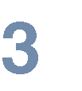
 | 設計為低延遲，但通常約 秒
 | 常用於直播至 或 等平台
 | 需第三方外掛或軟體來支援瀏覽器播放
 | 超低延遲，通常低於 毫秒，適合即時通訊
 | 專注於點對點通訊，如視訊通話和即時聊天
 | 內建於現代瀏覽器，無需

